Slide 1
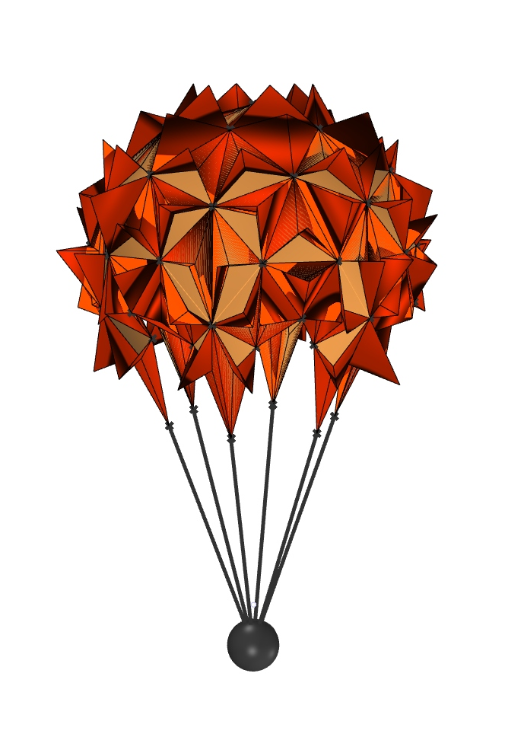

P#
<Computational Thinking for Design>
<2D Project – Parachute Design>
P#
Assignment
Context
Course
Date
2D Project – Parachute Design and Prototyping
Freshmore
Term 1
Computational
Design Thinking
2020
Student
<Description>
BEST PICTURE
Lim Thian Yew 1003158 Gao Fancheng 1004879
Joseph Low
1005013
Janani Sureshkumar
1005351
The objective of this project is to explore and evaluate the optimal parachute design for airdropping relief supplies to a remote village
To quantify the usefulness of the designs explored, factors such as the ability to fully utilize parachute material and the visibility of the parachute by the villagers were taken into consideration.
The spikes / flaps on the design are inspired by signal mirrors, which rely on reflecting flashes of light to relay SOS messages up to 200 KM away. The spikes aim to achieve a similar result, reflecting light from the sun in flashes at almost any angle, thereby dramatically improving the likelihood that villages will see it.
One challenge faced in this project was to find a way to construct the mesh that constitutes the parachute that is realistic, aesthetically pleasing roughly symmetrical about the center of the parachute.
Instructor
Jason Lim (ASD)
Norman Lee (ISTD)

Slide 2
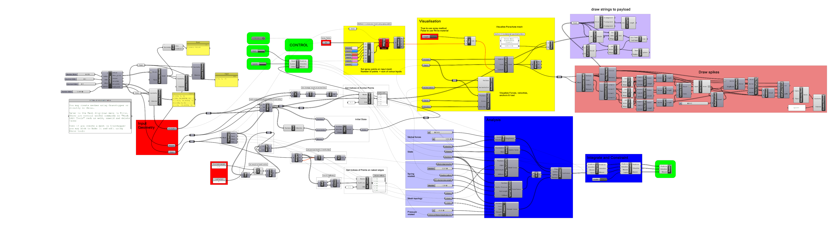
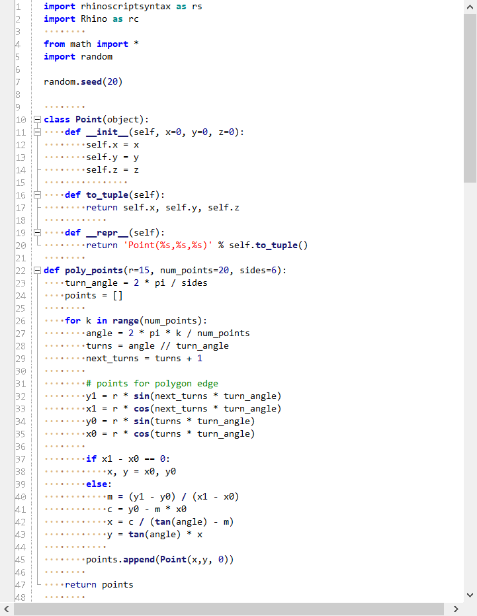
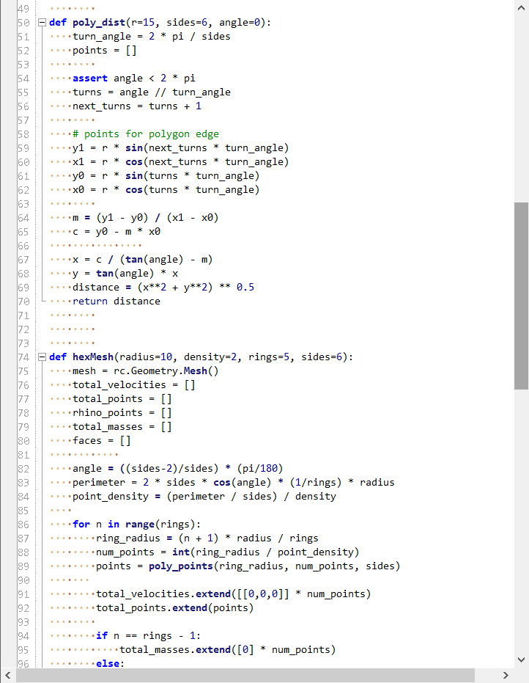
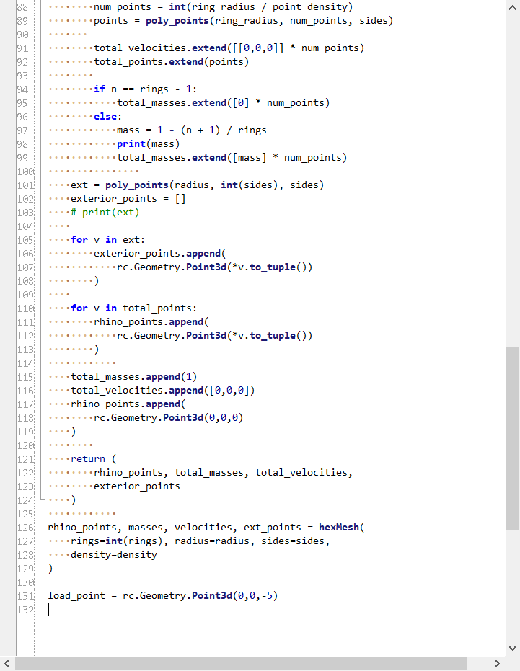
P#
<Computational Thinking for Design>
<2D Project – Parachute Design>
P#
<Grasshopper Program Overview>
Mesh points created using multiple rings of a regular polygon along the radius of the parachute, populating points evenly along the perimeter of each ring. Mesh faces are defined between points between neighboring rings. Mesh is created using Delaunay triangulation of points and faces.
3) Draw payload, strings
1) Generate initial mesh
2) Draw spikes coming out of parachute
Python code to generate initial mesh
Captions
01 Grasshopper definition explanation
01

Slide 3
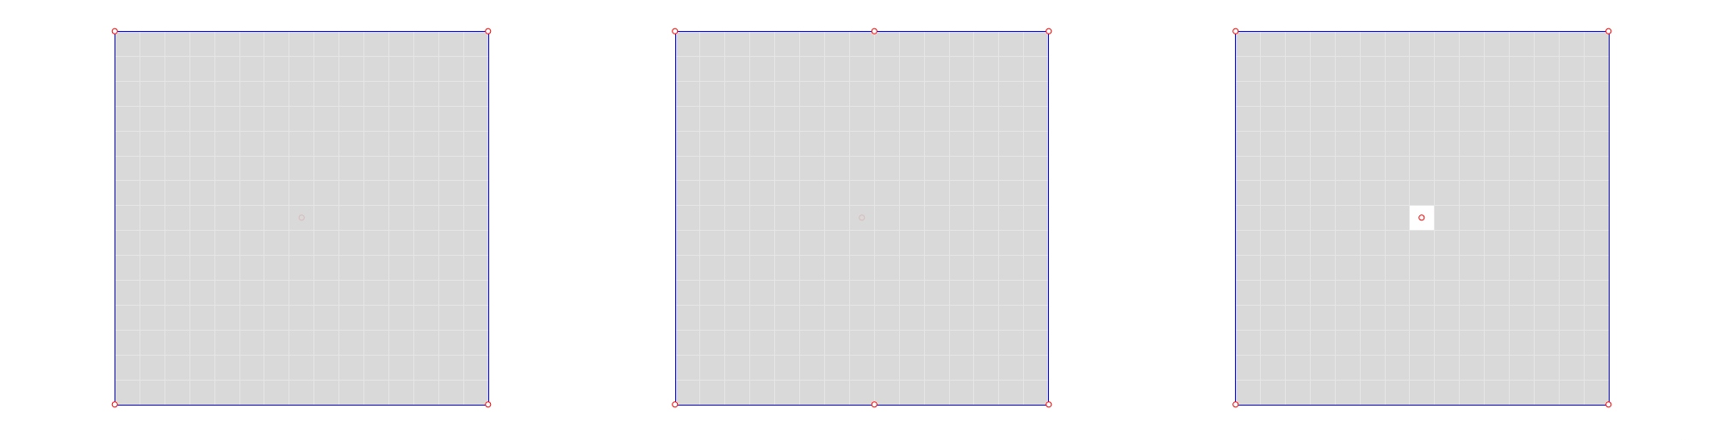
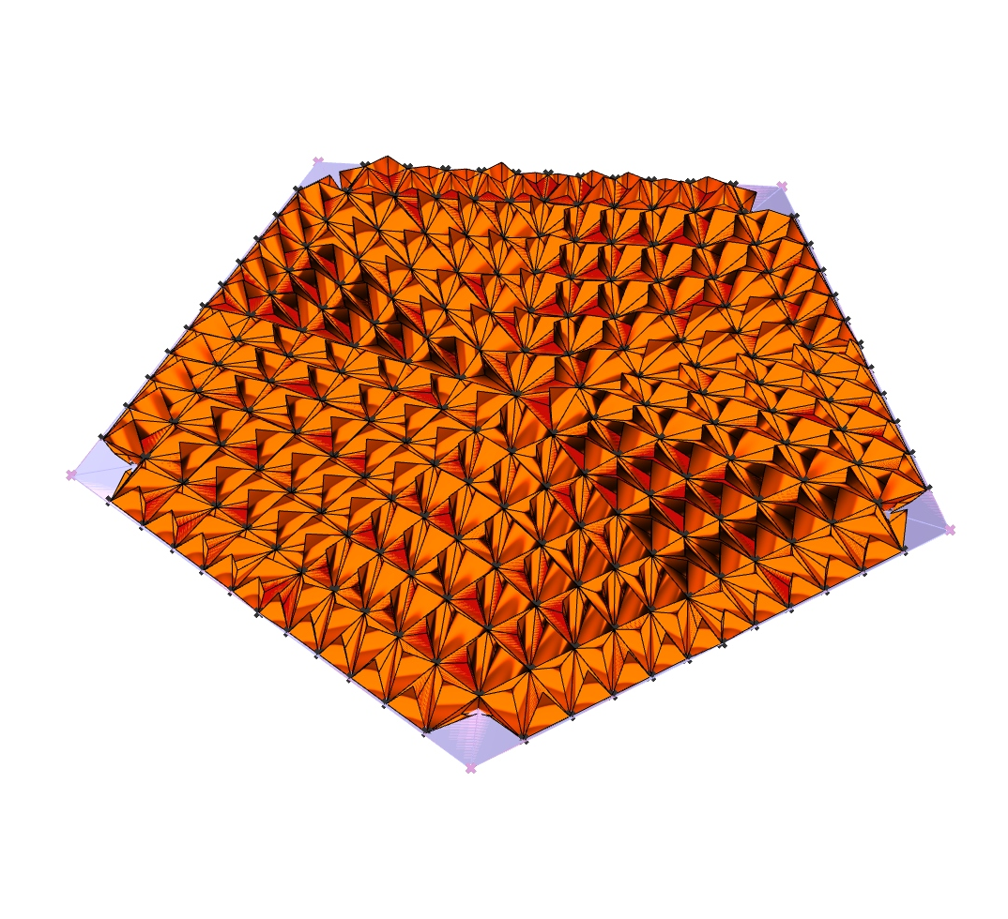
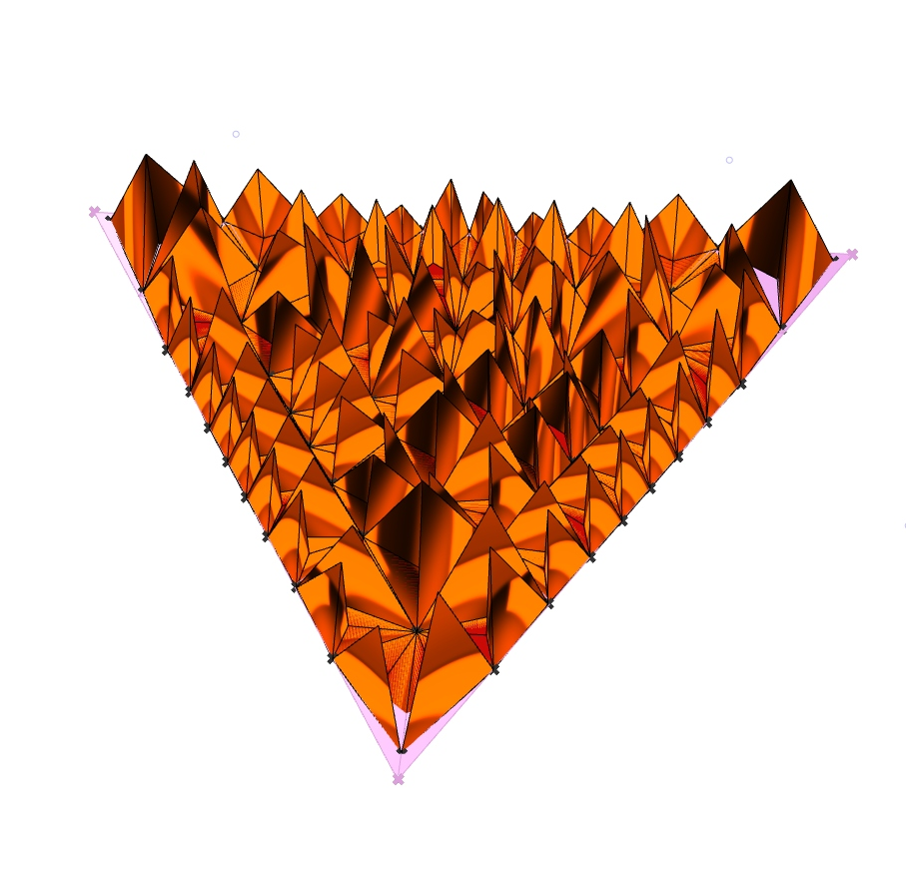
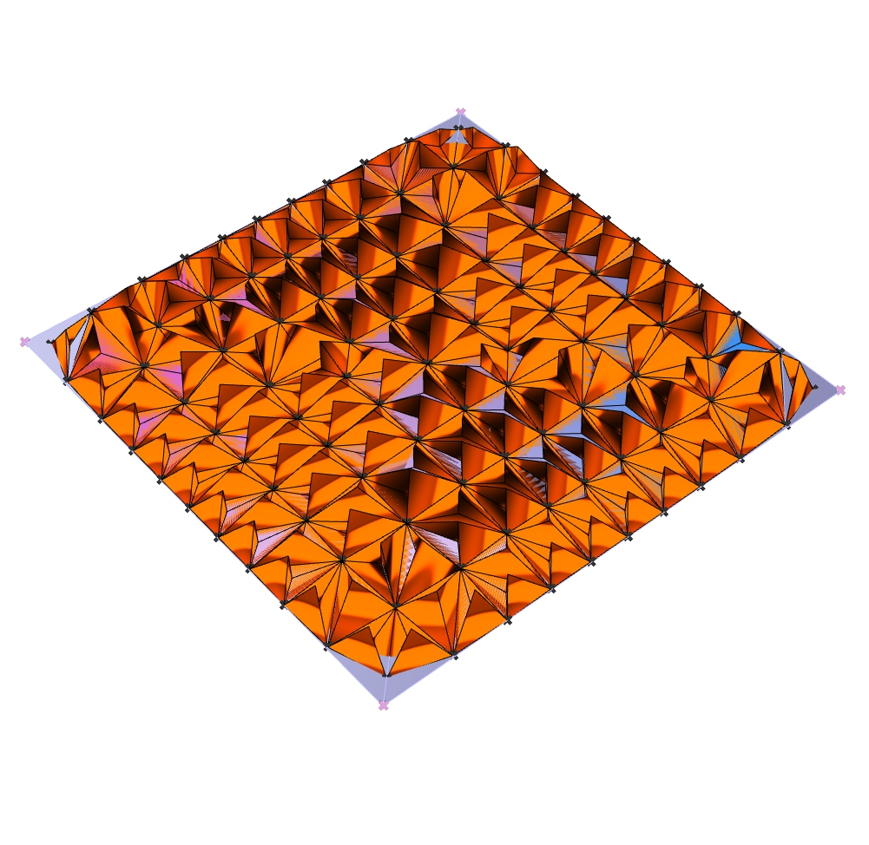
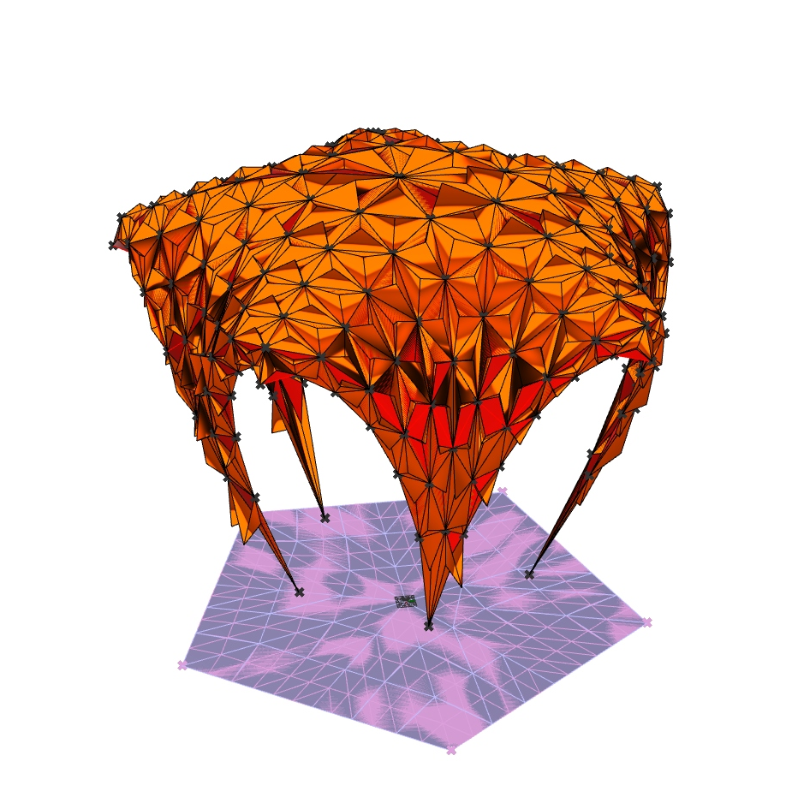
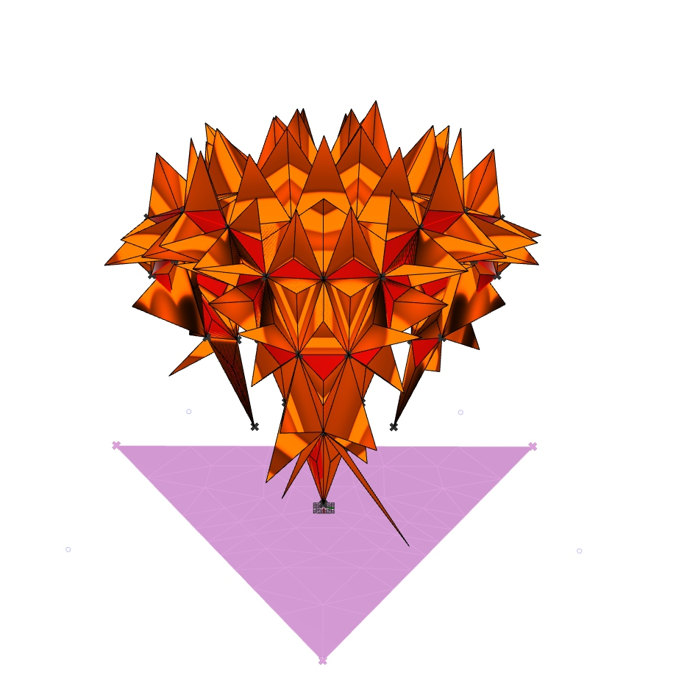
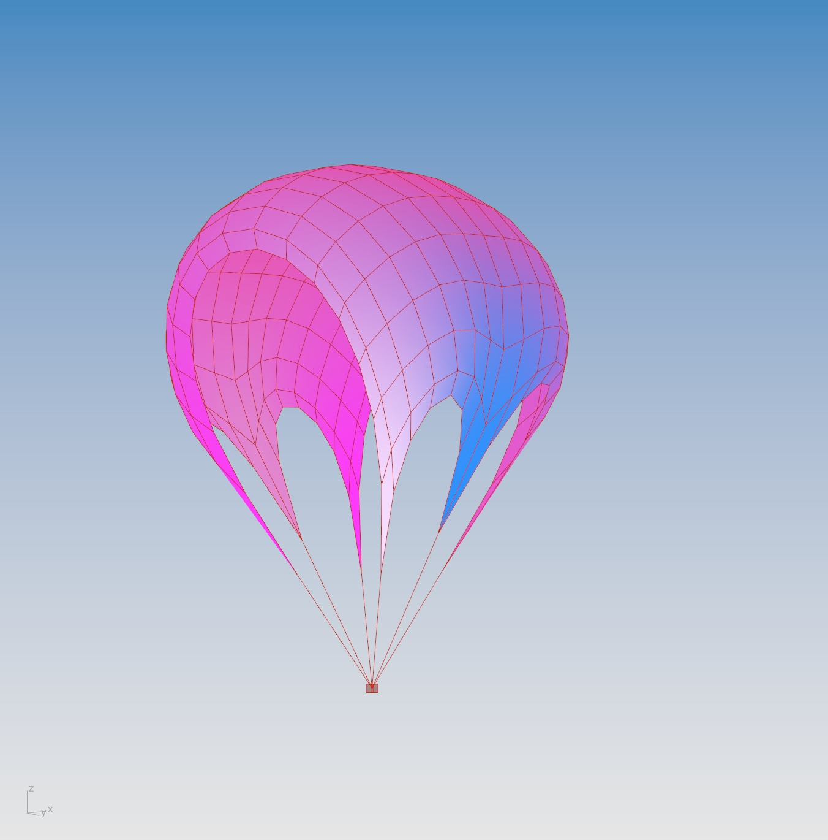
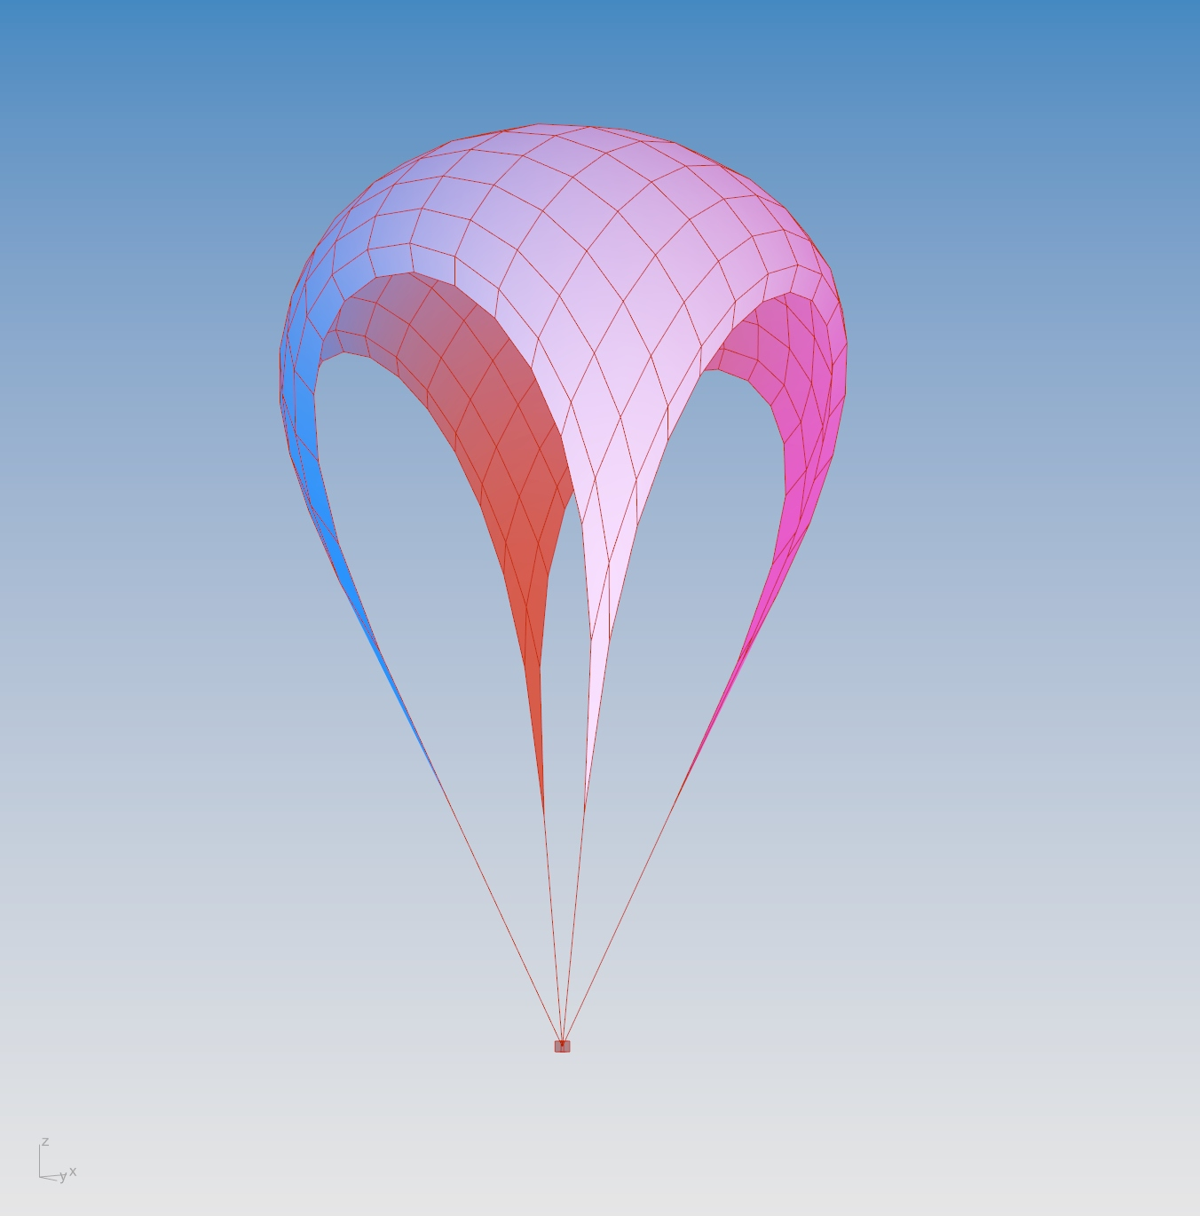
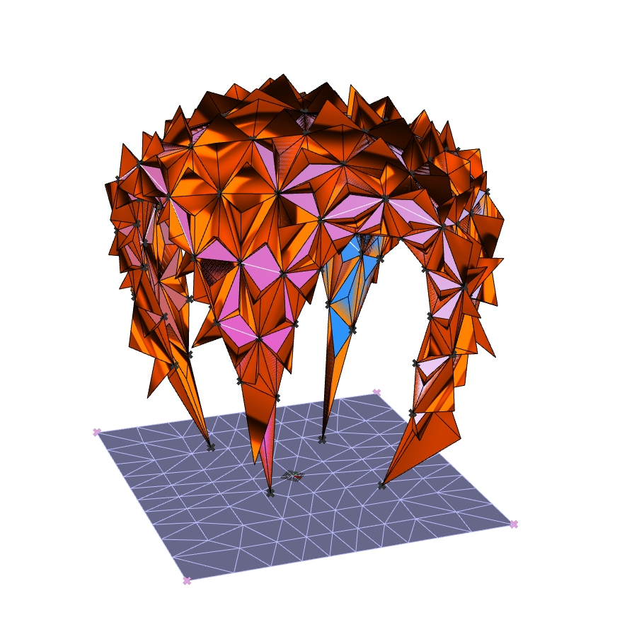
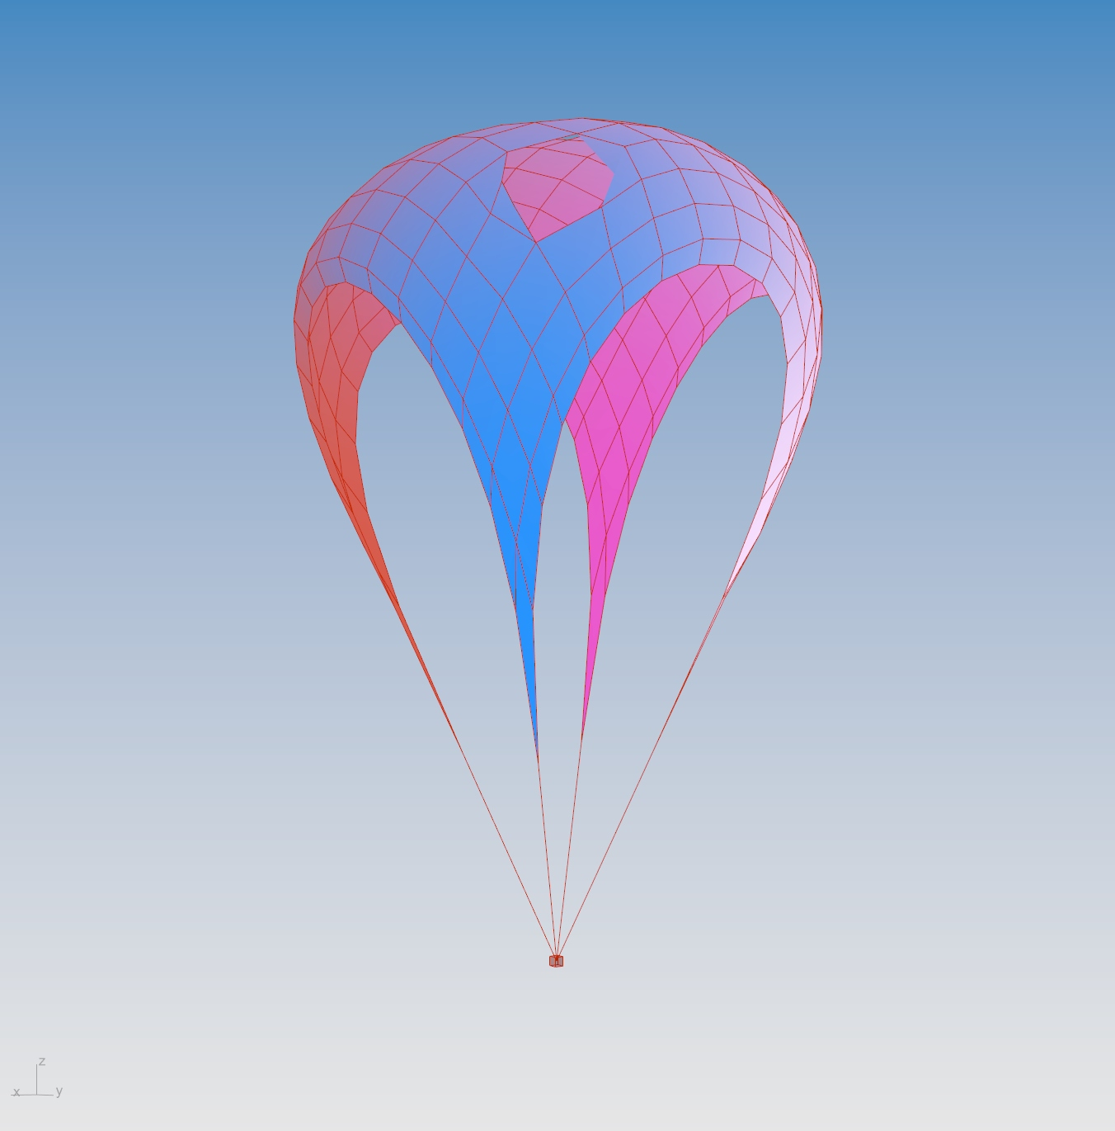
P#
<Computational Thinking for Design>
<2D Project – Parachute Design>
P#
<Variation Mapping>
Parameters used are number of sides P, rings R, and spike length S. Quantitative metrics used include how tessellatable the design is (a tessellatable design is better to prevent material wastage when cutting the parachutes out from sheets of material), and the surface area of parachute. A higher surface area is considered better as it decreases the impact velocity of the parachute.
P=5, R=6, S=0.39 Non-Tessellatable Surface Area: 23776
P=3, R=3, S=1 Tessellatable Surface Area: 12990
P=4, R=4, S=0.39 Tessellatable Surface Area: 20000
Captions
01 Initial state
02 Form found results
01
02

Slide 4
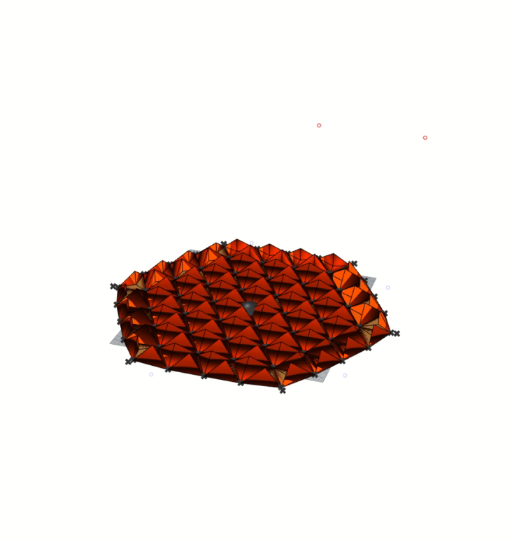
P#
<Computational Thinking for Design>
<2D Project – Parachute Design>
P#
VIDEO OF FORM-FINDING PROCESS
Captions
01 Animation
01

Slide 5
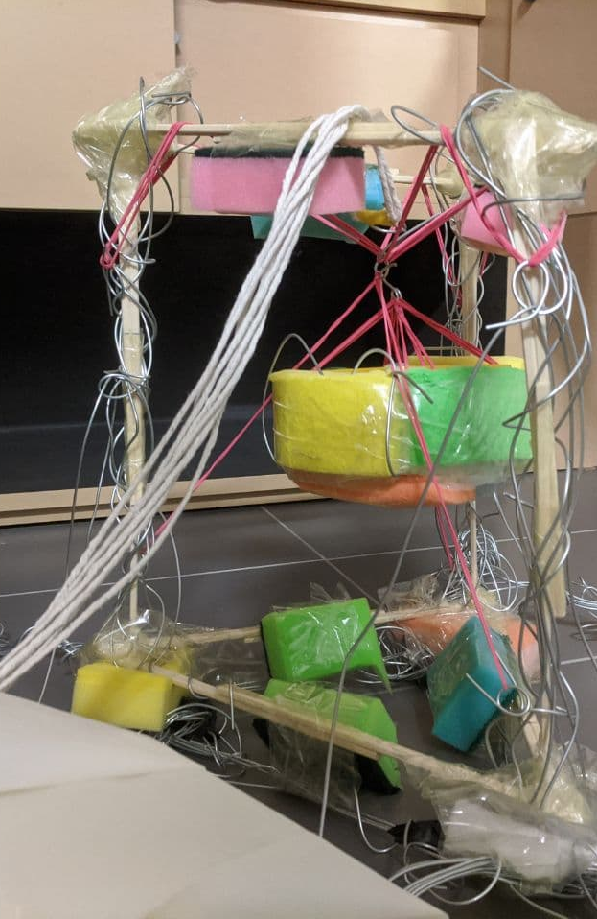
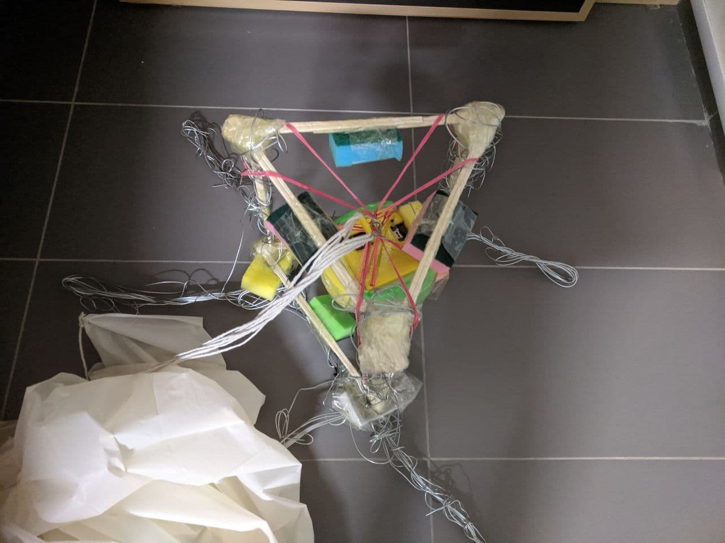
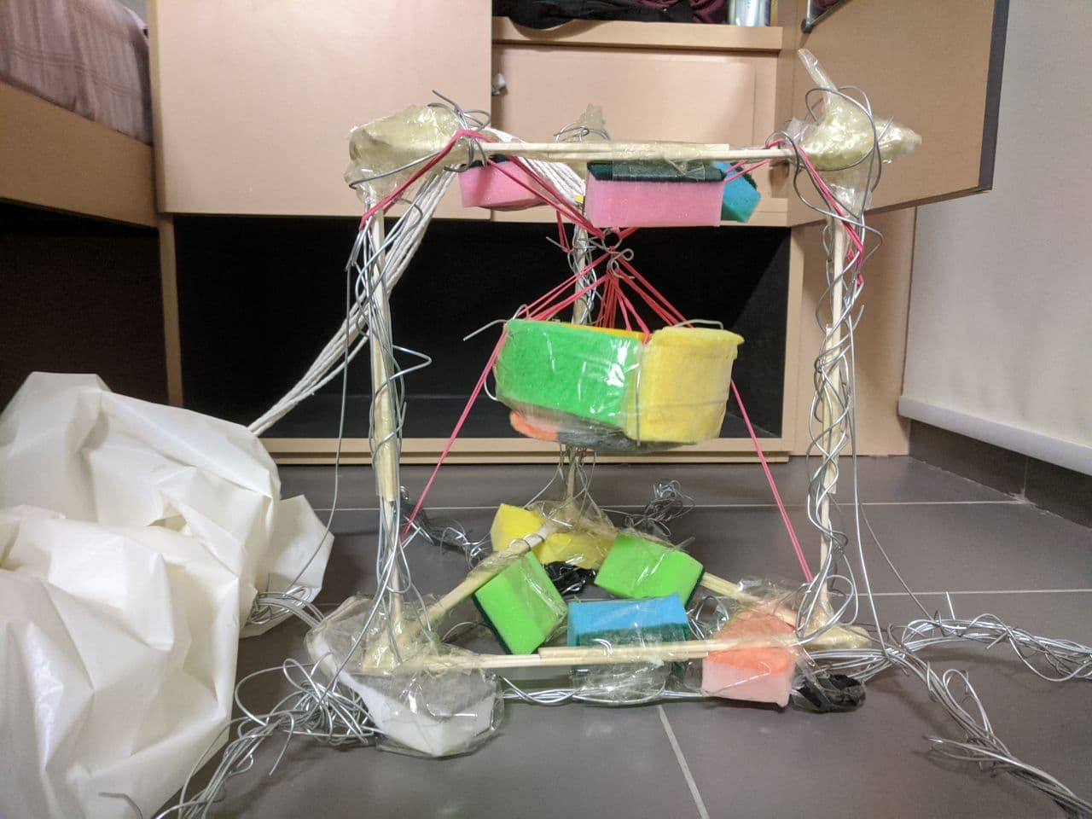
5
<Computational Thinking for Design>
<2D Project – Parachute Design>
5
PHOTOS/SKETCHES OF PROTOTYPE MAKING PROCESS / PROCESS
Captions
01 Perspective
02 Top
03 Front
01
02
03

